Slide 1
FDP
A solution for Flight Delays
Team 7 Data Science Challenge
Andres Tafur Bravo | Carolina Jativa | Deyang Hu
Haolian Qu | Jaeah Choi | Ruolan Li
Notes:
Good morning. We are FDP team and today we will present you about how the FDP software will change the way Tunisair manage flight delays.

Slide 2
AGENDA
01
06
OPPORTUNITIES AND RISKS
PROBLEM
02
SOLUTION
07
FINANCIALS
03
MARKET
08
REFERENCES
BUSINESS MODEL
04
09
APPENDICES
05
ROLLOUT PLAN
Notes:
CAROLINA

Slide 3
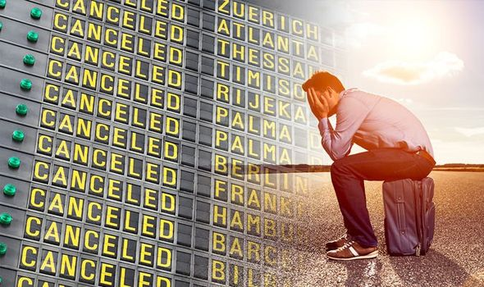
MOTIVATION
Notes:
CAROLINA
Once, I was Traveling from Ecuador to Miami with my family to my sister’s wedding, the flight was cancelled. We put our names in the waiting list, hoping we would be sent in the next flight available. We waited for 12 hours in the airport and passed custom several times, which was very irritating and stressful. We finally arrived 2 hours before the start of my sister wedding.

Slide 4
PROBLEM
Increase costs
Decrease efficiency
Decrease Customer Satisfaction
Flight delays impact to Tunisair:
Notes:
JAEAH
Flight delays impact to airlines increasing their costs, decreasing efficiency and loss of time.

Slide 5
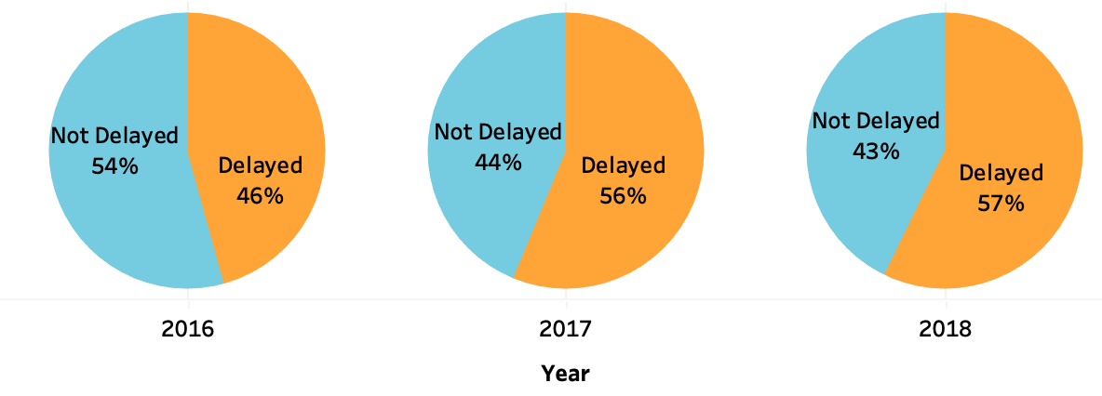
Percentage of delays 2016-2018 for Tunisair
Notes:
JAEAH

Slide 6
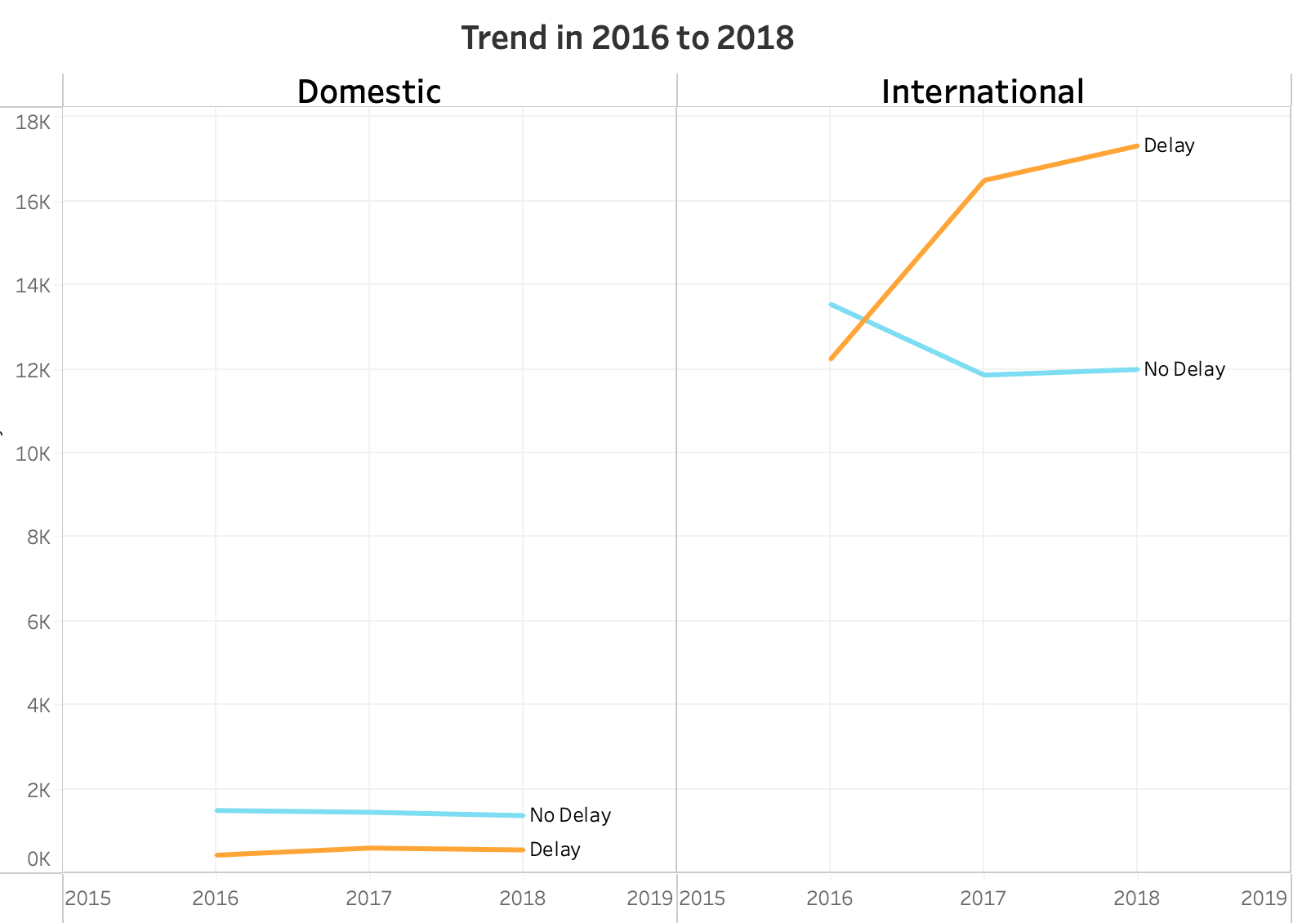
Tunisair Domestic vs. International Delays 2016-2018
17,326
12,242
Notes:
JAEAH

Slide 7
SOLUTION
Reduce costs
Efficient Schedules
Better Customer Satisfaction
Tunisair will:
Notes:
JAEAH
We developed this software with the objective of the integrated system of operations. At this moment, Tunisia Airline will have a flexible and efficient schedule of their flight, which leads to reduce their costs and improve their profit. Also, the operations will make passengers have better satisfaction on their travel experience..
Flight delays impact to airlines increasing their costs, decreasing efficiency and loss of time.

Slide 8
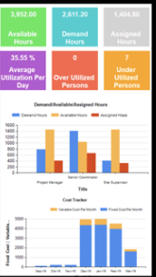
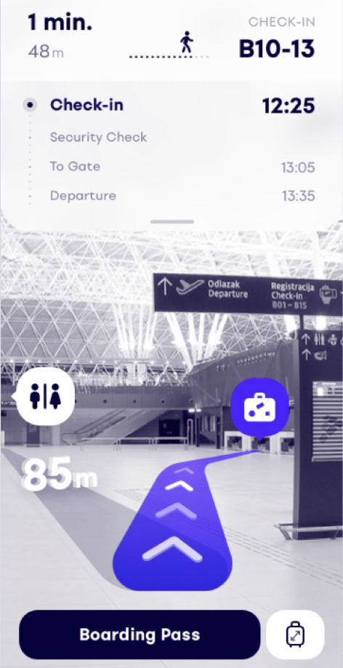
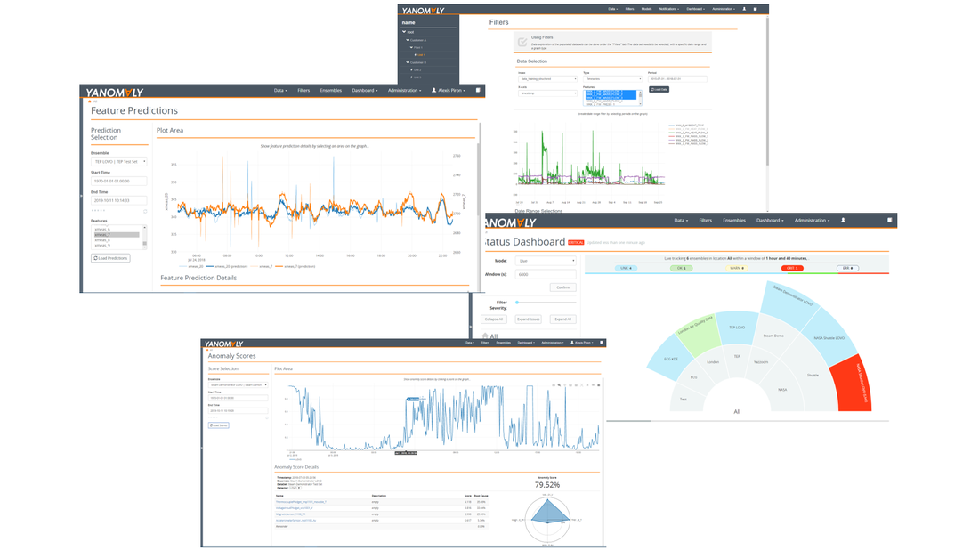
FDP PROTOTYPE PRODUCT
Notes:
JAEAH
We developed a software that would be integrated to allow passengers to use it as an APP in their mobile phones and tables and be able to reschedule their flights or book other flights lively.

Slide 9
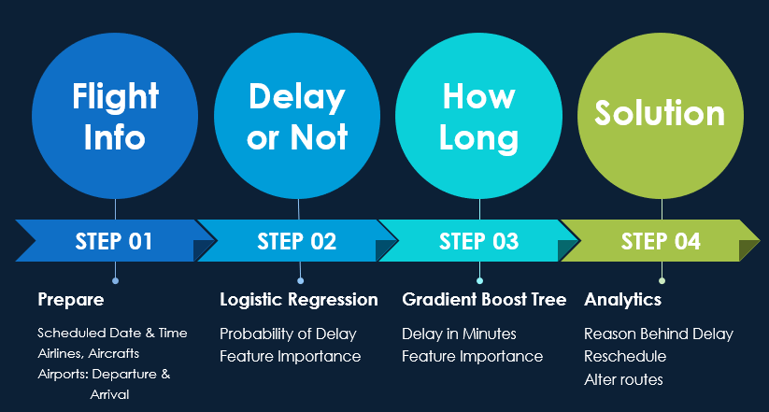
MODEL
Data Source: Tunisia Airlines Data Flight Delays
External Data: Aircrafts Types from FAA, World Airports Information
Notes:
HAOLIAN

Slide 10
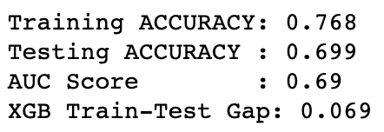
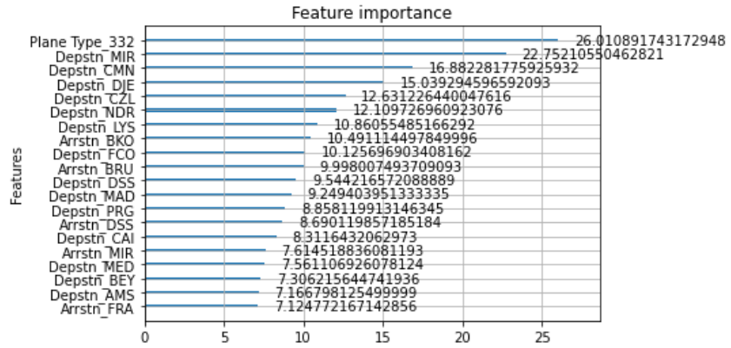
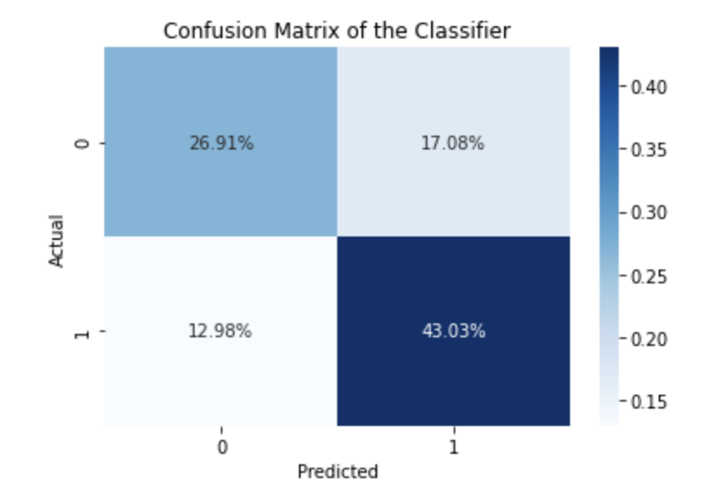
MODEL
Step 1: Delay or Not
Notes:
HAOLIAN
Confidence that we can estimate if the flight is delayed or not

Slide 11
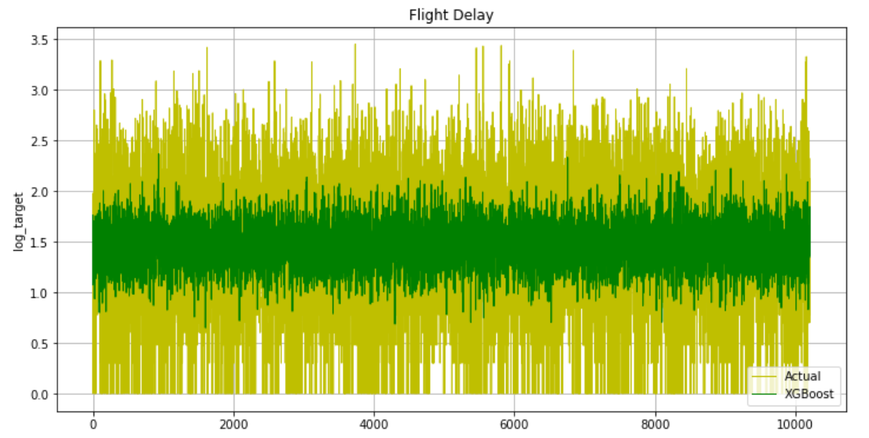
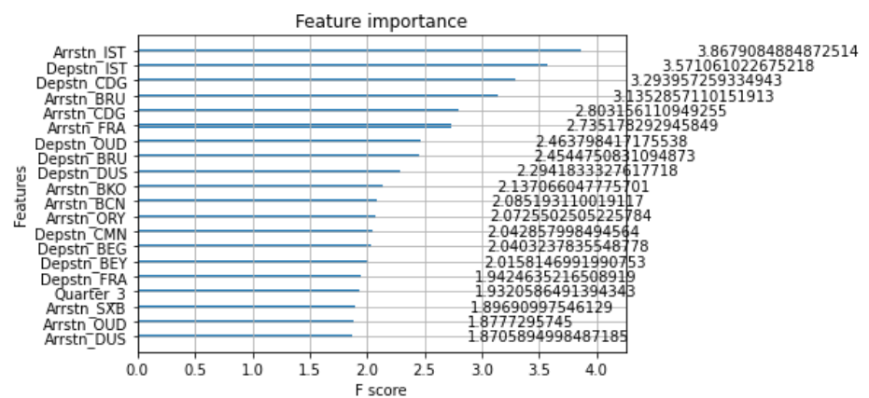
MODEL
Step 2: How Long are delays?
Mean Standard Error: 0.4078935
Notes:
HAOLIAN

Slide 12

MODEL
Other Data Sources that could improve the Model:
Average cost per minute of flight delay
Weather data around airports
Holiday information for different countries
Notes:
HAOLIAN

Slide 13
MARKET SIZE
According to IATA, the worldwide airline industry in 2021:
0.6%
Global GDP
21.3%
World Trade Growth
3,384 million Passengers departures
*IATA. (n.d). Economic Performance of the Airline Industry.
Notes:
Ruolan
Currently, the airline industry market has a market size of 0.6% global GDP, 21.3% world trade growth, and about 3,300 million passengers, according to IATA. This can represent an opportunity for Tunisia Airline.

Slide 14
COMPETITION
THEM
FDP
Allocate slots to arriving and departing flights, but assume that flights arrive and depart exactly within their scheduled slots
Predict whether a flight will arrive or depart later to have better scheduled slots
Notes:
Ruolan
comparing with other competition companies…
Their companies allocate slots to arriving and departing flights, but assume that flights arrive and depart exactly within their scheduled slots
However, Tunisia Airline, based on FDP model, it can present whether a flight will arrive or depart later to have flexible scheduled slots

Slide 15




FDP BUSINESS MODEL
App for passengers
4,723 million passengers worldwide
Other airlines
54 Africa
58 Asia
46 Latin
America
Tunisair
8,000 employees
101 destinations
30 aircrafts
*Statista (n.d). Number of scheduled passengers boarded by the global airline industry from 2004 to 2021(in millions)
Notes:
ANDRES
https://www.statista.com/statistics/564717/airline-industry-passenger-traffic-globally/

Slide 16
LAUNCH & PROMOTION
App for passengers
Social media
Digital advertising
Influencer campaigns
Other airlines
Public Relations
Digital branding
Field marketing
Airlines trade shows
Introduction
& Funding
Public Relations
Digital branding
Events
Notes:
ANDRES

Slide 17
FINANCIAL DATA TABLE
EXPENSES
R&D | $100,000
EQUIPMENT | $50,000
ADVERTISING | $30,000
LICENSE & PATENTS | $300,000
BUILDING | $30,000
BRANDING | $30,000
TOTAL EXPENSES | $540,000
LAUNCH SALES PRICE | $1,000,000
ESTIMATED REVENUE | $510,000
FUNDING PLAN
CROWFUNDING CAMPAIGN | $50,000
INVESTOR 2 | $100,000
INVESTOR 3 | $100,000
LOANS
BANK LOAN | $200,000
TOTAL FUNDING | $550,000
*Launch Sales Price includes implementation
*Estimated Prices have been established based on similar technological projects
Notes:
ANDRES

Slide 18
CHALLENGES TO BE FACED IN 2030
TECHNOLOGY
ENVIRONMENT
SOCIETY
Newer technologies
Better ML models
Pandemics
Government regulation of emissions and noise pollution
Changes in consumer behavior
Protection of passengers data
Notes:
Imagine that in 2030, there will be many risks and challenges for the way of transportation by air. On a technological level, the next 10 years may see unimaginable developments and advances in technology, with new power technologies and entirely new vehicles. So much so that for our machine learning models, new types of computational technology algorithms will also emerge. From an environmental perspective, the spread of mass pandemics, energy consumption, and air and noise pollution will also have an impact on Flight. From the point of view of people and society, in the future, the behavior of consumers, the authentication system of cross-border flights, and the privacy protection of personal data are also challenges for flights and airline companies.

Slide 19


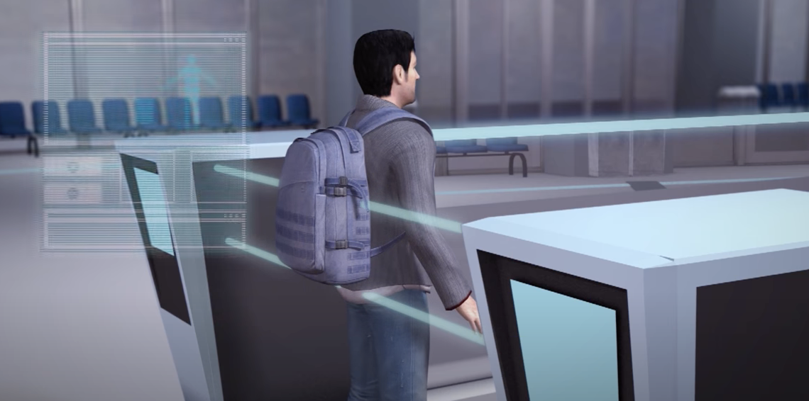
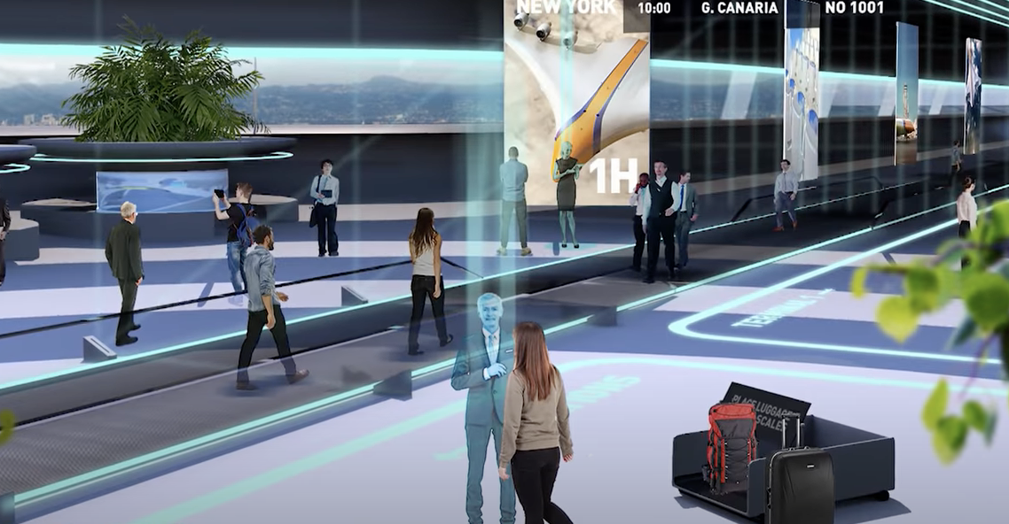
2030 AIRPORTS
Biometric scanners to verify identity
Virtual shopping stations having goods delivered home
Laser molecular body scanners
Robots as virtual assistants
Notes:
Deyang
In the future airport of 2030, with the application of new biometric identification system and intelligent AI, the time of check-in and waiting process of tourists will be shorter than now, and with the application of new flight technology, the whole journey time will be significantly shortened. Even short delays are intolerable for passengers to accept. Companies must predict flight times and take action to avoid delays. Our predictive models will be essential in the future of flight systems.

Slide 20
BEST AND WORST CASE SCENARIO
2.8 BN
-0.7 BN
According to IATA PAX Forecast for 2030:
Additional passengers per year by 2030 in the current trends scenario
Fewer passengers per year in 2030 than in the current trends scenario
Notes:
DEYANG
Based on current technology and expectations, and taking into account the positive impact of all of the above, it is conservatively estimated that the number of passengers will increase by 2.8 billion. On the other hand, the negative impact could also lead to a 700 million decrease in the number of tourists traveling with the flight system.

Slide 21
HOW OUR MODEL WILL BE RELEVANT IN FUTURE 2030?
*KPMG. (n.d.). Aviation 2030
*IATA. (n.d). PAX Forecast 2030.
According to KPMG Aviation 2030, the airline industry could save from delay reduction:
~US$0.8 BN/PER YEAR
According to IATA Forecast 2030:
2.1 x
Number of air passengers journey in 2030 compared with today
Notes:
CAROLINA
This crowdedness will result in more frequent delays in most major airports worldwide.

Slide 22
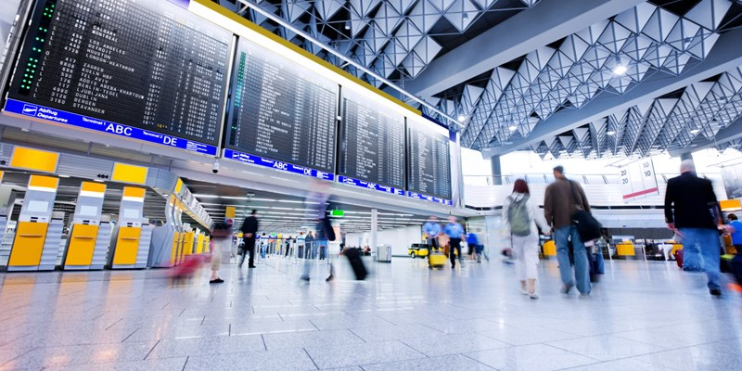
Notes:
In 2030, we expect double of the passengers today and they will expect as customers to have a fast and automated experience given the technological advances, with FDP airlines will be able to provide customer with a fast and sophisticated experience at the airport.

Slide 23
APPENDIXES

Slide 24
INTERVIEWS
AirPort Technology- Roundtable: what should the future of aviation look like?
Ali Shah, CEO of TravelUp
The industry must take some responsibility in adapting to the new reality. Many passengers are still experiencing frustrating refund delays. If we are to restore consumer confidence in the aviation industry, we need to make passengers feel like governments, airlines and travel companies are on their side. TravelUp is proposing that the CAA introduces a new system, in association with IATA, whereby money is only transferred to the relevant airline once the flight has departed. This “trust model” would enable funds to be returned quickly if the flight does not leave and this new system would replicate what happens in other areas of the industry.
Luis Felipe de Oliveira, ACI World
Investment will have to be heavily focused on technology. In ten years we’ll probably see the totality or majority of airports using touchless technologies, biometrics, facial recognition. The way that the industry will adapt to improve health standards will continue as well with a lot of measures that will have to be linked with technology.
Andrew O’Connor, SITA
With the expected recovery, we anticipate that over the next five to ten years the industry will start to focus on a return to the ‘golden age’ of travel from the 50s and 60s. Border management, identity and risk, operations and automation will continue to be a focus area even after the pandemic. Airports, for example, will look to make travel less visible and intrusive for the passenger so that passengers have a walkthrough airport experience. [With biometrics], once enrolled, your face becomes your passport so you can walk through an airport without using your passport and you will no longer have to stop at any touchpoint from check-in to boarding.

Slide 25
AirPort Technology- Roundtable: what should the future of aviation look like?
Chris Goater, IATA
The story of the decade to come will, we hope, be a return to traffic growth beyond the 2019 peak from 2024 onwards. This will mean that some of the key challenges that are associated with rising passenger numbers will come back. Two key examples are infrastructure and environment. Crowded infrastructure will be a problem and we know that we cannot expect to simply build our way out of it. Similarly, airspace capacity is limited by political and procedural problems. These challenges are capable of being overcome, but the ‘pause’ in growth as a result of Covid-19 gives us a rare opportunity to get ahead of the game. We will need to work closely with our airport and air navigation service providers to ensure infrastructure, in terms of costs and capacity, is fit for purpose once this pandemic crisis is behind us. With the environment, the implementation of the Carbon Offsetting and Reduction Scheme for International Aviation is so important.
Dr Saba Al-Rubaye, Cranfield University
Without a reassessment of technology and infrastructure, it is uncertain how the industry, and the finite airspace it relies on, will accommodate the predicted data growth. Aviation industry experts can be better prepared to manipulate these deviations and leverage them successfully by being aware of the top trends for the future of aviation. To enable these efficiencies, a new generation of technology, 5G and high-bandwidth satellite communication services is emerging to integrate an array of specialist applications with artificial intelligence, the internet of things and big data capabilities.
Ali Shah, TravelUp
In ten years, the pandemic should be a distant memory, with the travel industry thriving once again. If all goes to plan and the new trust system is implemented, we will have engendered a healthier relationship between airline, agent and passenger, and have years of customer feedback through which to further tailor our systems.

Slide 26
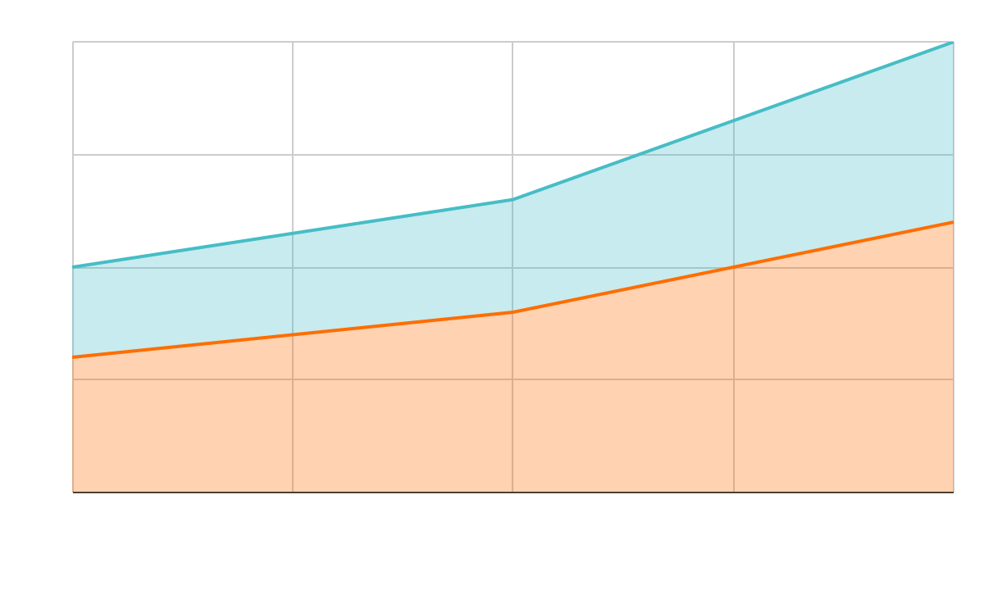
ICAO AIR PASSENGERS FORECAST 2030
International
Domestic

Slide 27
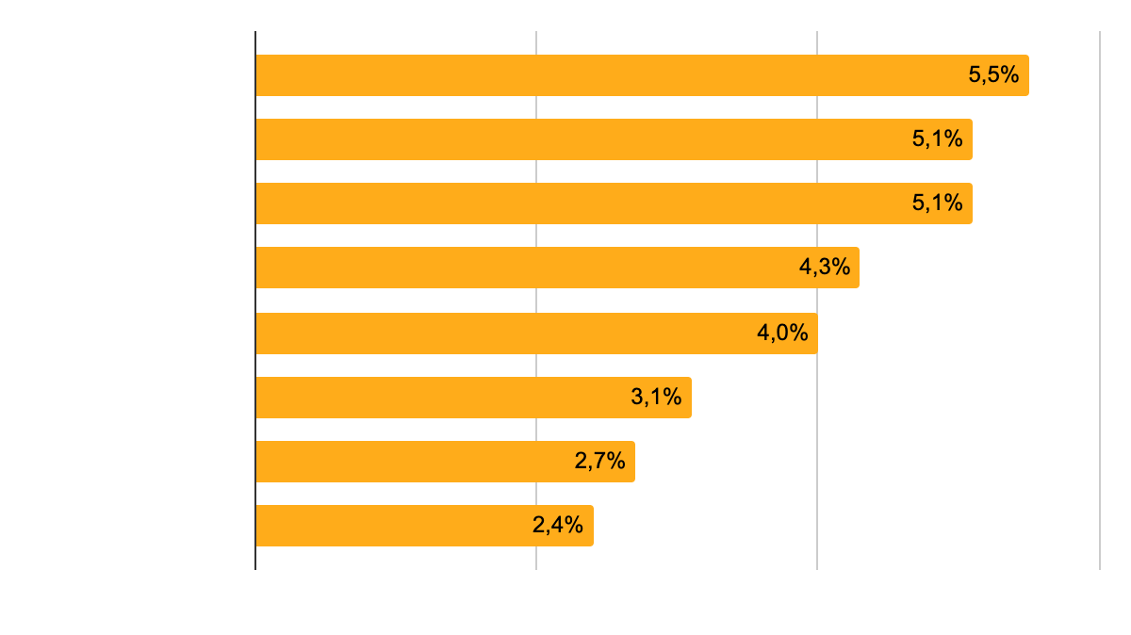
MARKET SIZE AND GROWTH
*Statista. (n.d). Estimated annual growth rates for passenger air traffic from 2020 to 2039, by region.
Estimated annual growth rates for passenger air traffic from 2020 to 2039
Notes:
Ruolan
In this graph we can see that Africa, Latin America and Asia will have the highest growth rates for passengers from 2020 to 2039

Slide 28
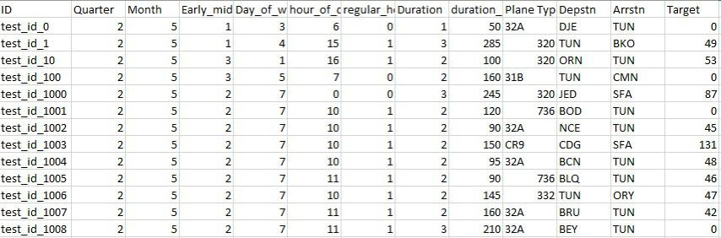
MODEL OUTPUT
Notes:
Ruolan
In this graph we can see that Africa, Latin America and Asia will have the highest growth rates for passengers from 2020 to 2039

Slide 29
LEAN CANVAS BUSINESS MODEL
Solution
Unfair Advantage
Problem
Reduced costs
Efficiency
Better customer satisfaction
Unique Value Proposition
Customer Segments
Increase of costs
Inefficiency
Loss of time
Software to reschedule future flights
Reschedule flights based on prediction of delayed flights
Airlines
Airports
Passengers
Key Metrics
Cost Structure
Channels
Revenues
Data from recent flight information
Satisfaction interviews of passengers
Cost data related to flight delays
Product Development
Marketing Expenses
Annual airline subscription to software
Word of mouth
Referrals
Speeches
Conventions
Notes:
Today, there are many optimization models developed that allocate slots to arriving and departing flights, but these models assume that flights arrive and depart exactly within their scheduled slots. Most of the time flights experience arrival or departure delays or cancellations (Maybe this page goes to Appendix?)

Slide 30
COUNTRY PAIRS WITH THE BIGGEST CHANGES IN PASSENGER NUMBERS
International Market
Domestic Market
Country pair | Annual Growth %
India - UAE | 8.1%
China - Thailand | 6.2%
China - Japan | 5.0%
Country pair | Annual Growth %
Within India | 7.2%
Within China | 5.3%
Within US | 2.0%

Slide 31
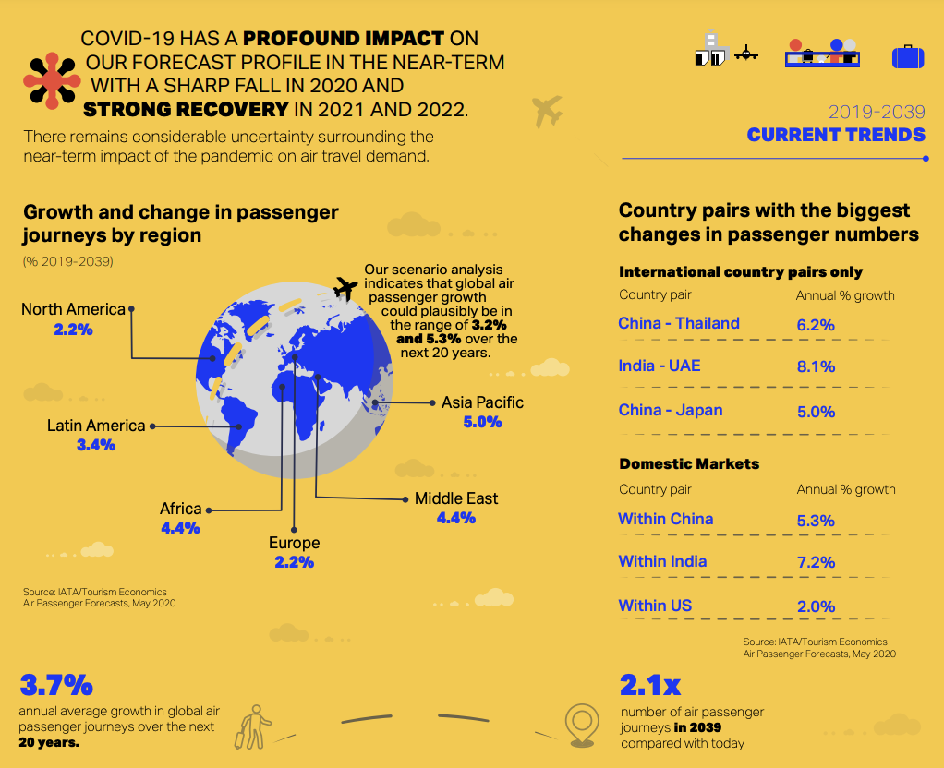
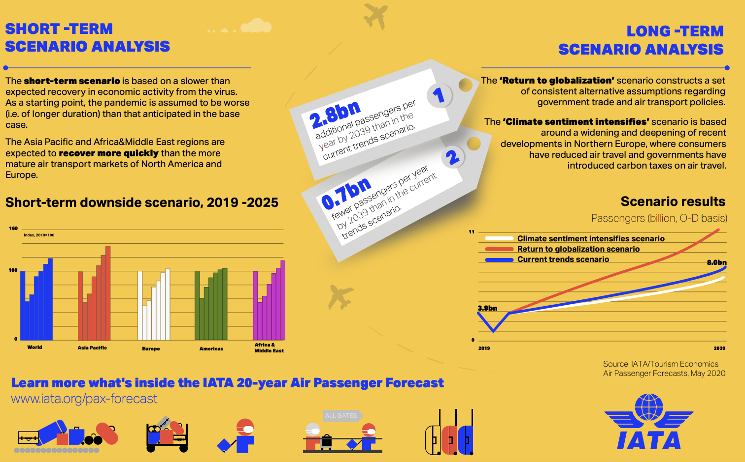
IATA PAX Forecast infographic

Slide 32
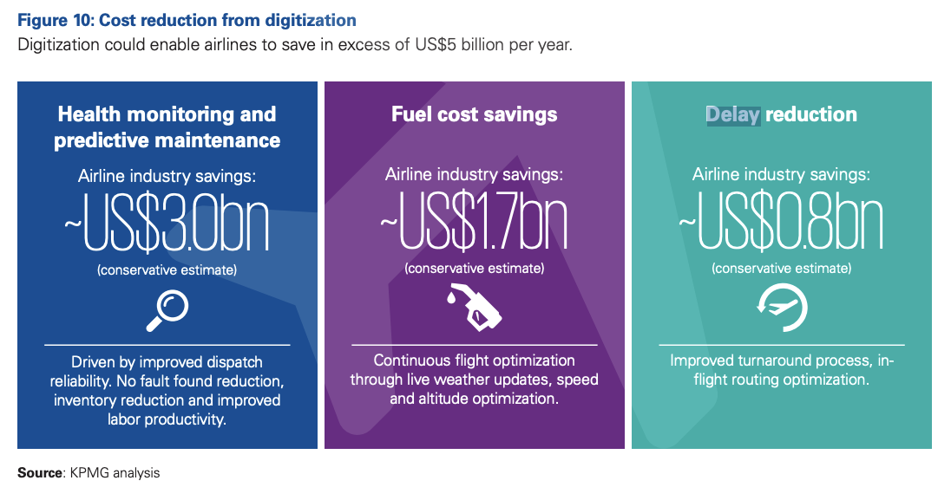
Aviation 2030 - Disruption and its implications for the aviation sector

Slide 33
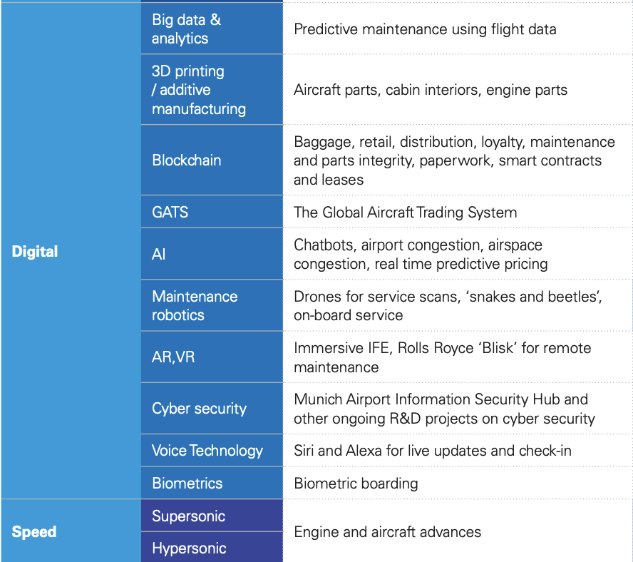
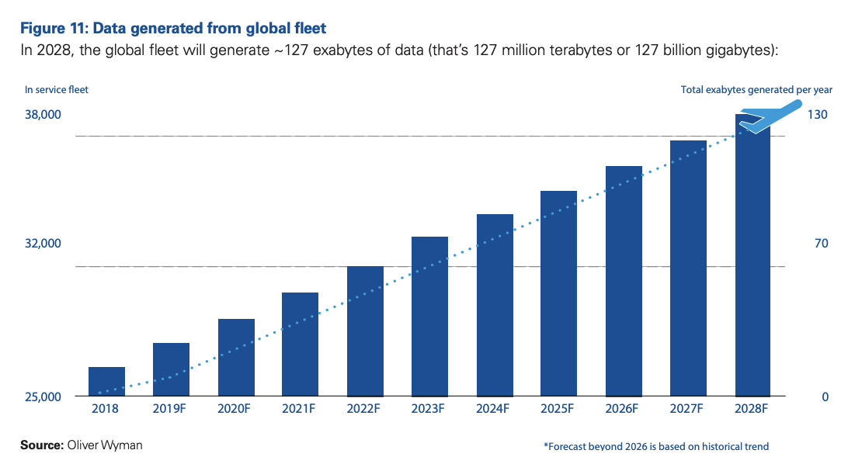
Aviation 2030 - Disruption and its implications for the aviation sector

Slide 34
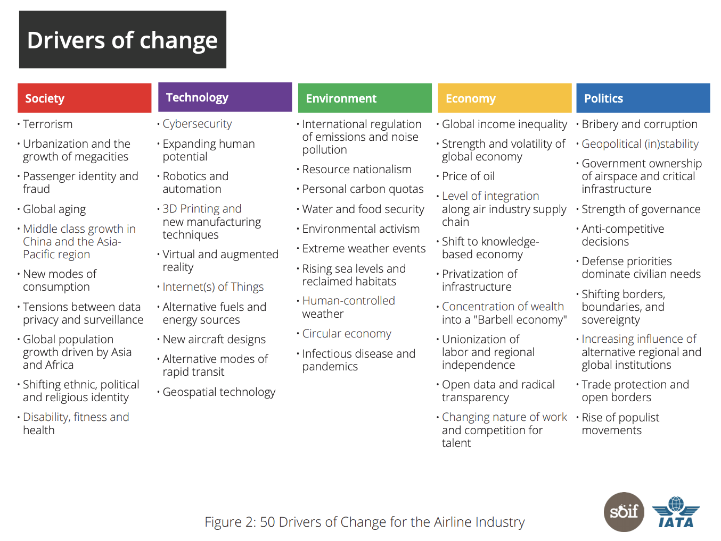
IATA - Future of Aviation Industry 2035

Slide 35
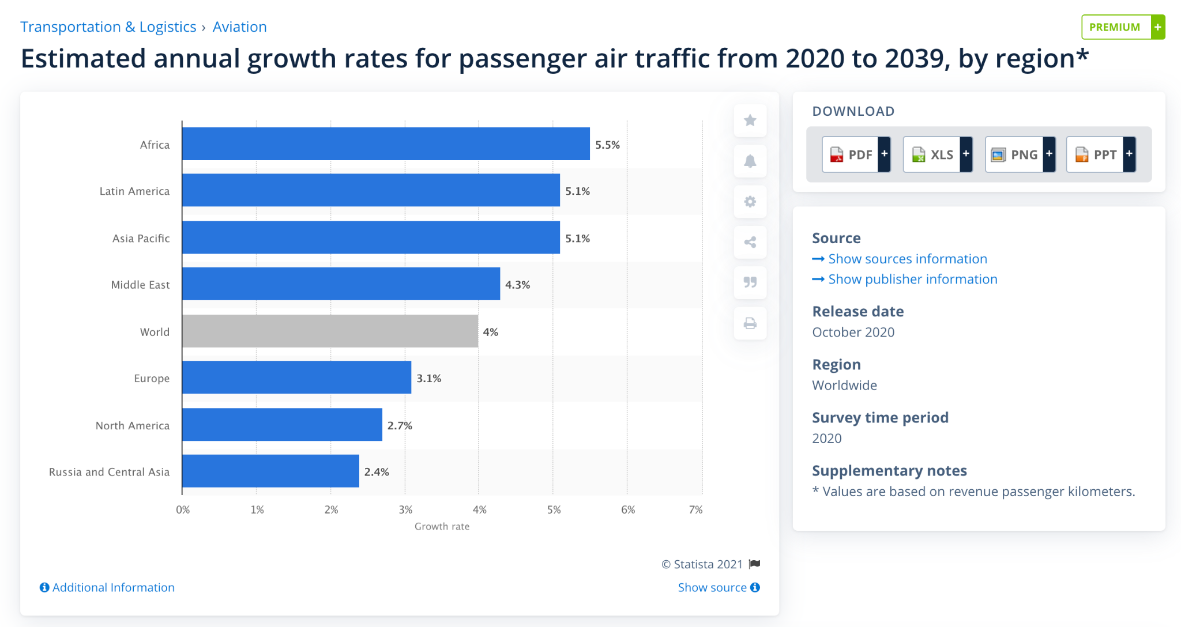
IATA - Future of Aviation Industry 2035

Slide 36
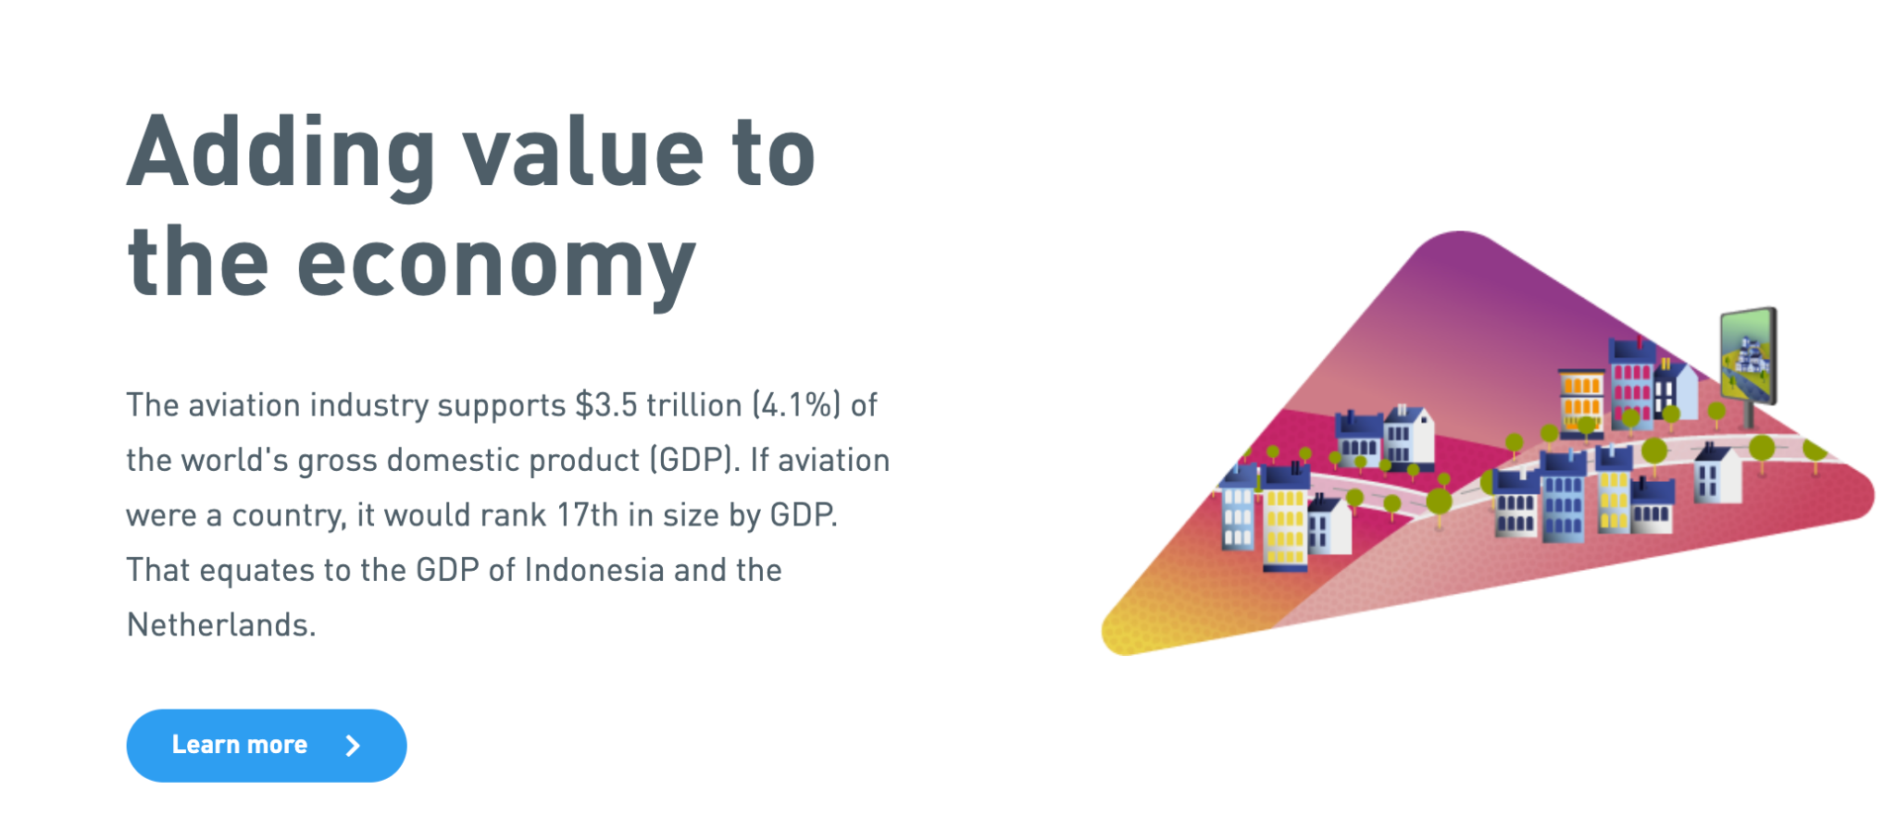
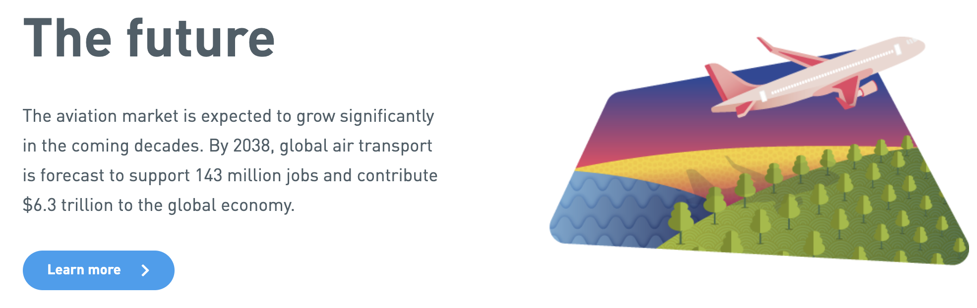
The future: Aviation Benefits Beyond Borders

Slide 37
REFERENCES
Cassidy, Ian. (2018). Applying Predictive Analytics to Flight Delays. Retrieved May 8th 2021 from: https://engineering.upside.com/applying-predictive-analytics-to-flight-delays-85413ca4939f
Berti, Adeli. (2020). Roundtable: what should the future of aviation look like? Retrieved May 8th 2021 from: https://www.airport-technology.com/features/aviation-future-covid-19/
Bureau of Transportation Statistics. (n.d.). On-Time Performance - Reporting Operating Carrier Flight Delays at a Glance. Retrieved May 8th 2021 from: https://www.transtats.bts.gov/HomeDrillChart.asp
Cheng et al. (2019). Study of Flight Departure Delay and Causal Factor Using Spatial Analysis. Retrieved May 8th 2021 from: https://www.hindawi.com/journals/jat/2019/3525912/
del Pecho et al. (2020). Building a flight delay prediction model with machine learning. Retrieved May 8th 2021 from: https://developers.amadeus.com/blog/flight-delay-prediction-machine-learning
IATA. (n.d.). Future of Aviation Industry 2035. Retrieved May 8th 2021 from: https://www.iata.org/contentassets/690df4ddf39b47b5a075bb5dff30e1d8/iata-future-airline-industry-pdf.pdf
IATA. (n.d.). PAX Forecast infographic. Retrieved May 8th 2021 from: https://www.iata.org/contentassets/e938e150c0f547449c1093239597cc18/pax-forecast-infographic-2020-final.pdf
ICAO. (n.d.). ICAO Strategic Objective Economic Development of Air Transport. Retrieved May 8th 2021 from: https://aerolatinnews.com/destacado/2036-forecast-reveals-air-passengers-will-nearly-double-to-7-8-billion/
ICAO. (n.d). Future of Aviation. Retrieved May 8th 2021 from: https://www.icao.int/Meetings/FutureOfAviation/Pages/default.aspx
Grasso, Ilaria. (2020). Q&A: in conversation with new ACI director-general Luis Felipe de Oliveira. Retrieved May 8th 2021 from: https://www.airport-technology.com/features/conversation-new-aci-director-general-luis-felipe-oliveira/
Herbas, Javier. (2020). Using Machine Learning to Predict Flight Delays. Retrieved May 8th 2021 from: https://medium.com/analytics-vidhya/using-machine-learning-to-predict-flight-delays-e8a50b0bb64c

Slide 38
REFERENCES
ICAO. (n.d). Future of Aviation. Retrieved May 8th 2021 from: https://www.icao.int/Meetings/FutureOfAviation/Pages/default.aspx
Grasso, Ilaria. (2020). Q&A: in conversation with new ACI director-general Luis Felipe de Oliveira. Retrieved May 8th 2021 from: https://www.airport-technology.com/features/conversation-new-aci-director-general-luis-felipe-oliveira/
Herbas, Javier. (2020). Using Machine Learning to Predict Flight Delays. Retrieved May 8th 2021 from: https://medium.com/analytics-vidhya/using-machine-learning-to-predict-flight-delays-e8a50b0bb64c
KPMG. (n.d.). Aviation 2030 - Disruption and its implications for the aviation sector. Retrieved May 8th 2021 from: https://assets.kpmg/content/dam/kpmg/xx/pdf/2019/12/aviation-2030.pdf
Lambelho, et al. (2020). Assessing strategic flight schedules at an airport using machine learning-based flight delay and cancellation predictions. ELSEVIER. Journal of Air Transport Management.
Statista. (n.d.). Estimated annual growth rates for passenger air traffic from 2020 to 2039, by region. Retrieved May 8th 2021 from: https://www.statista.com/statistics/269919/growth-rates-for-passenger-and-cargo-air-traffic/
Statista. (n.d.). Estimated annual growth rates for passenger air traffic from 2020 to 2039, by region. Retrieved May 8th 2021 from: https://www.statista.com/statistics/269919/growth-rates-for-passenger-and-cargo-air-traffic/
Yazdi et al. (2020). Flight delay prediction based on deep learning and Levenberg-Marquart algorithm. Retrieved May 8th 2021 from: https://journalofbigdata.springeropen.com/articles/10.1186/s40537-020-00380-z

